Slide 1











Opsis AI
Opsis AI
Intelligent Healthcare Assistant
Bridging the gap between complex medical data and everyday understanding
AI Health Intelligence
Data Accuracy
99.2%

Slide 2






OVERVIEW
Opsis AI
The Problem
70%
80%
Medical Jargon Barrier
Symptom Search Anxiety
Healthcare Access Gap
70% of patients struggle to understand their lab test results
80% of online symptom searches lead to unnecessary panic
Urgent need for accessible health literacy tools to bridge information divides

Slide 3








Capabilities
Opsis AI
Our Solution
AI Symptom Checker
Medical Report Analyzer
Interactive Health Dashboard
Intelligent triage categorizes urgency (Emergency / Urgent / Moderate / Low) and provides self-care guidance
Upload lab reports, get flagged biomarkers with simple explanations and actionable insights
Personalized Health Score (0–100) with visual progress rings to track your wellness journey
E
U
M
L
Making healthcare accessible and understandable for everyone — empowering users to take control of their health data

Slide 4





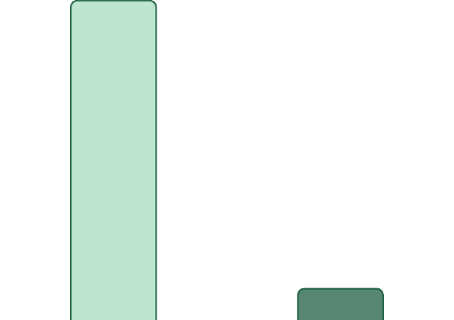




Market Opportunity
Opsis AI
Market Opportunity
Growth Drivers
Rising health awareness post-pandemic
$500B+
Global Digital Health Market (TAM)
Increasing adoption of AI in healthcare
$50B
India Healthcare Tech Market (SAM)
Growing demand for patient-centric solutions
Government push for digital health infrastructure

Slide 5







Technology
Opsis AI
Technology & Competitive Edge
Frontend
Competitive Advantages
React.js
Vite
Tailwind CSS
Framer Motion
Real-time PDF text extraction (client-side)
Backend
Structured JSON AI responses
Node.js
Express.js
Color-coded urgency badges
Export to PDF functionality
Database & AI
MongoDB
Generative AI integration
Proof of Execution (Challenges Overcome)
Deployment
Server cold start optimization with UptimeRobot
Netlify (frontend)
Render (backend)
CORS configuration for production domains
SPA routing fixes for Netlify deployment
PDF font extraction error handling

Slide 6









Monetization
Opsis AI
Business Model & Monetization
FREE
PREMIUM
ENTERPRISE
FREE
$0
Additional Revenue Streams
Basic symptom checker
Limited report uploads
Standard AI responses
Partner integrations with diagnostic labs
PREMIUM
$9.99/month
Unlimited reports
Detailed health insights
PDF exports
Premium health content subscriptions
Health timeline
Telemedicine referral commissions
ENTERPRISE
Custom
API access
White-label solutions
Hospital integrations
Dedicated support

Slide 7








Current Status
Opsis AI
Current Status & Traction
Fully functional web app live at opsisai.netlify.app
Backend deployed on Render cloud platform
AI Symptom Checker with urgency categorization
Medical Report Analyzer with biomarker flagging
Interactive Health Score Dashboard
PDF Export functionality
Secure user session management
6-Month Roadmap
Q1
Q2
Q3
Q4
User authentication & health history timeline
Multilingual support (Bengali, Hindi)
Doctor integration for remote consultations
Mobile app development

Slide 8




Opsis AI
Join Us in Revolutionizing Healthcare
A world where everyone can understand and act on their health data with confidence
Try Now
Partner
Let's Talk
opsisai.netlify.app
Collaborate with us for healthcare integrations
Contact us for investment opportunities
Opsis AI
Website: opsisai.netlify.app
Institution: Haldia Institute of Technology
Department: Information Technology (B.Tech)

